Slide 1


REPORTING MODULE
PROJECT
Presented by:
Aditya Jain
Ashish Tiwari Gaurang Gupta Palash Rastogi Sinjini Guha
Suhani Khurana

Slide 2
CONTENTS
Introduction
Scope
Tools and Architecture
Walkthrough
Challenges

Slide 3
INTRODUCTION
A web UI application that compliments the bank by providing each user with an inventory report related to transaction, accounts opened and the account statement of desired account

Slide 4
CURRENT DELIVERABLES
We have following deliverables in this project.
Report generation on UI
Reports of accounts opened on desired time range and type
Similar reports for Transaction details and Account Statement
Charts for easy comprehension and analysis
Alert messages
Cross Browser support

Slide 5

TOOLS AND ARCHITECTURE
We have used the following technologies in developing this project.
Interface has been developed on IDE
Eclipse Mars 4.5.0
Angular-JS has been used to create front end controller.
We have used MVC Architecture.

Slide 6
ER-DIAGRAM

Slide 7
DFD

Slide 8
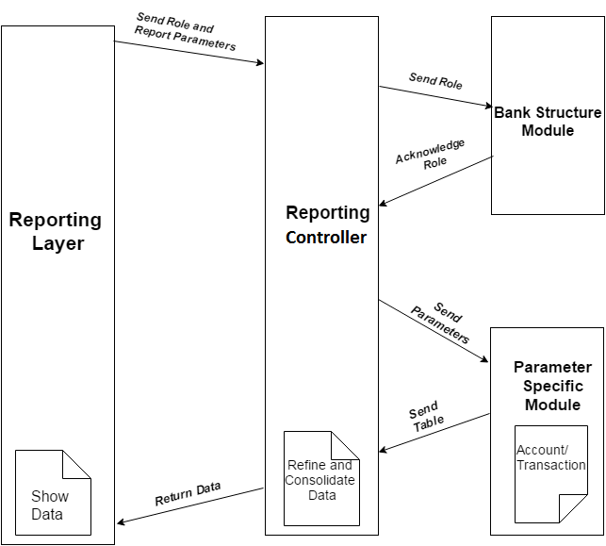
ARCHITECTURE

Slide 9
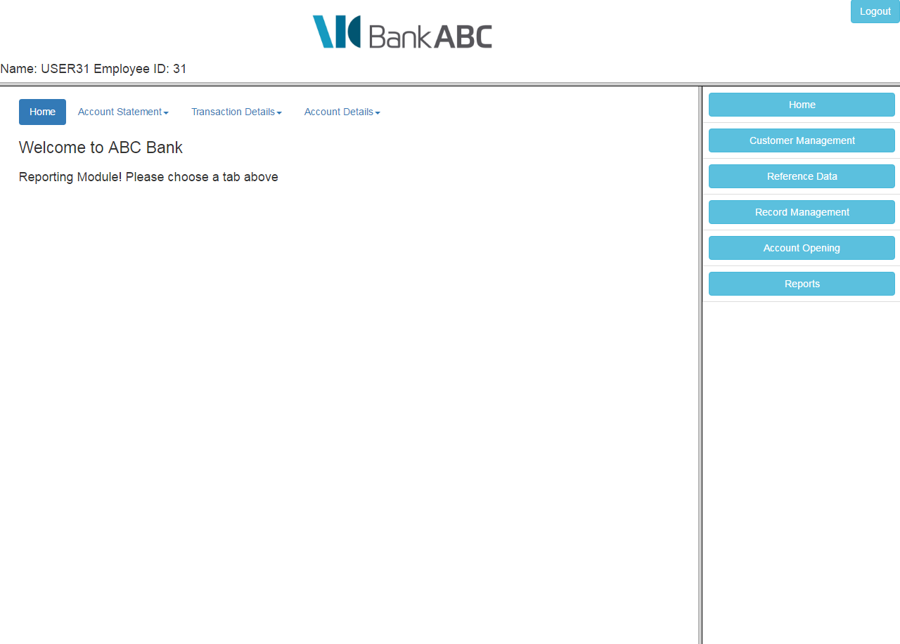
HOME PAGE

Slide 10
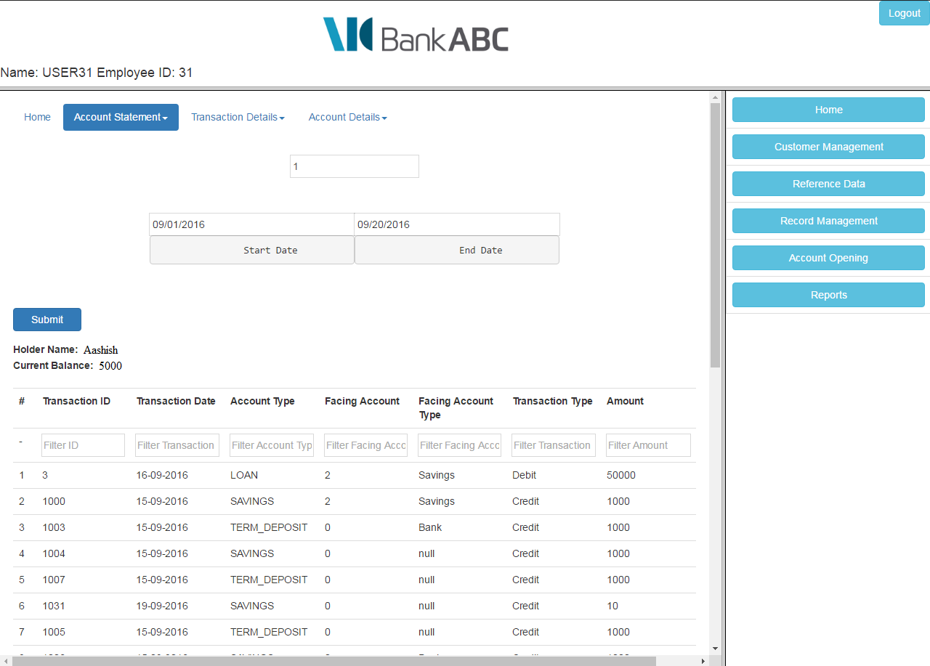
ACCOUNT STATEMENT

Slide 11
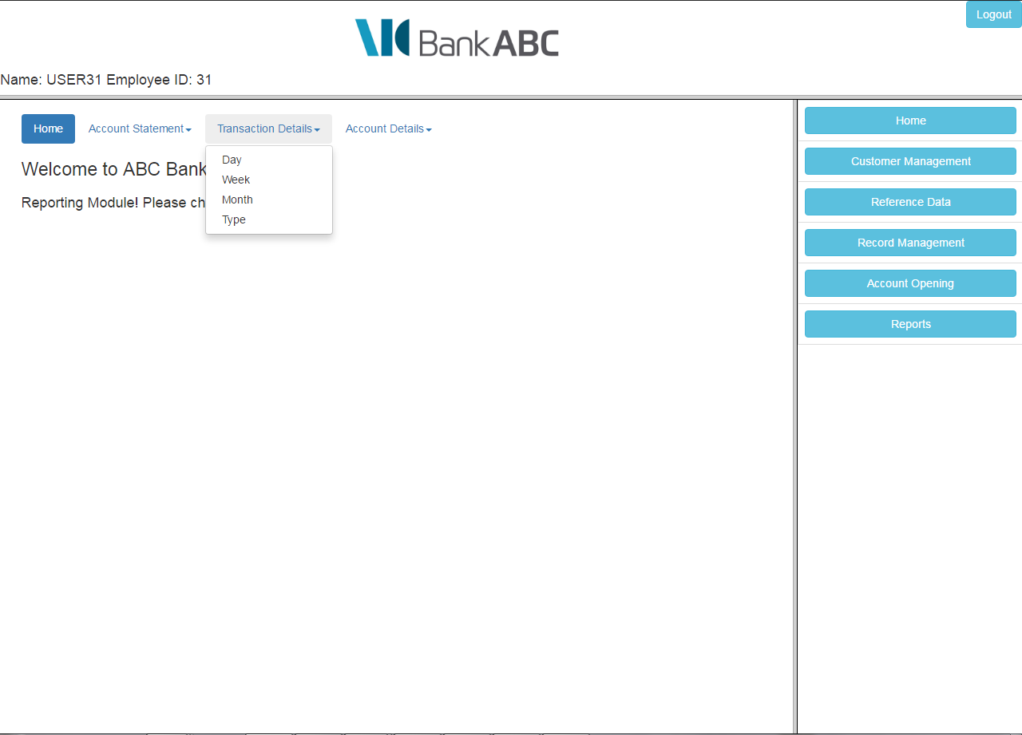
TRANSACTION DETAILS

Slide 12
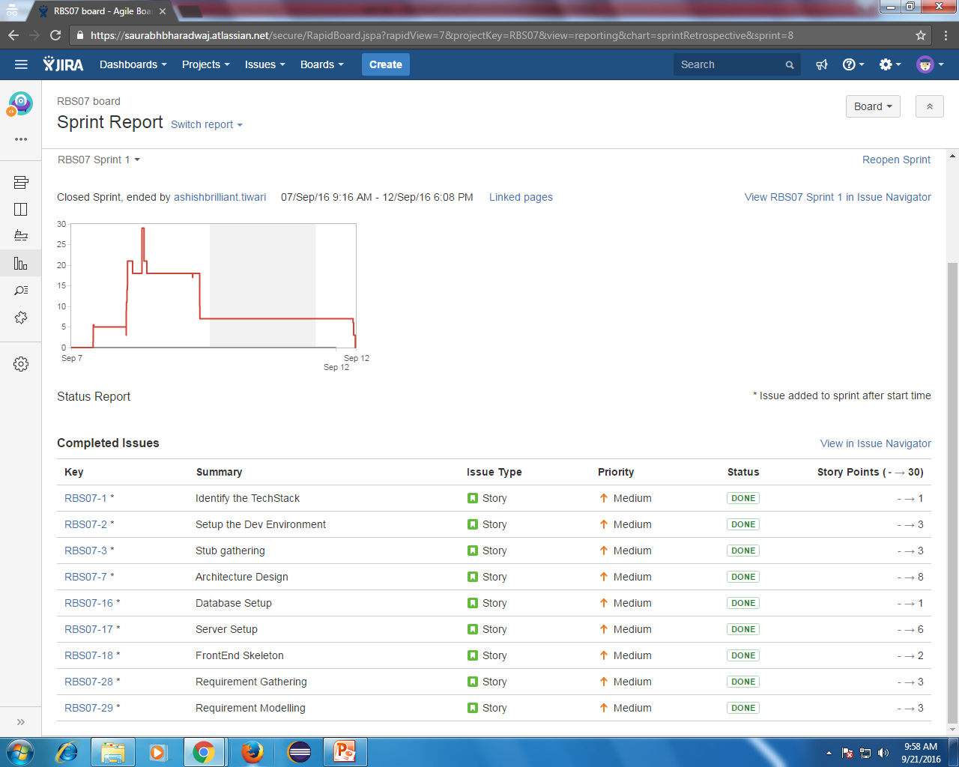
SPRINT 1

Slide 13
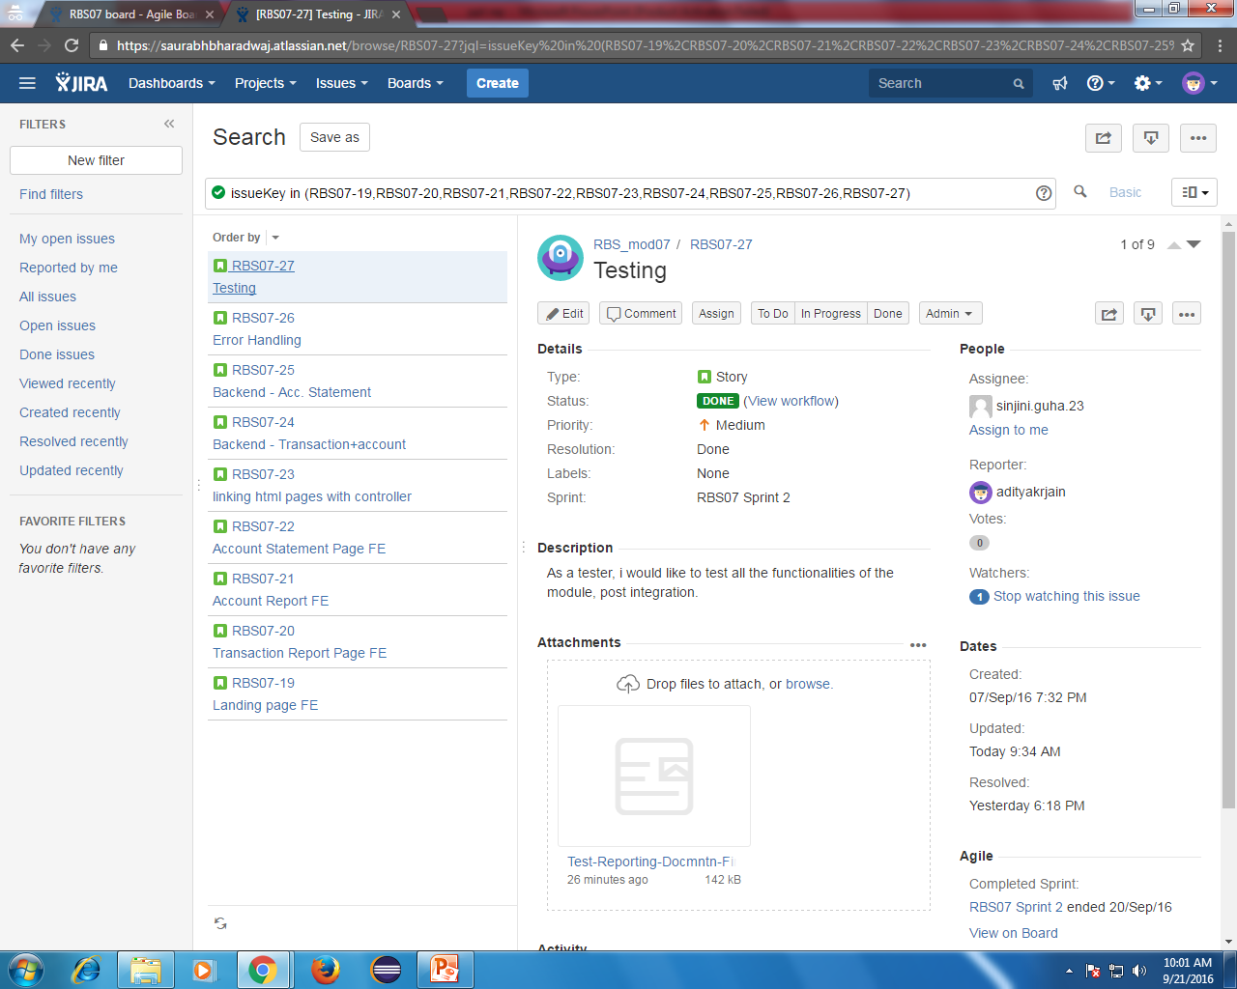
SPRINT 2

Slide 14
KEY LEARNINGS
Core values
Agile methodology
AngularJS and Bootstrap
JIRA and SVN

Slide 15
CHALLENGES
Integration

Slide 16
THANK YOU!!! ☺

